Slide 1
MULTIPLICATION CHATS
By Dr. Nicki Newton

Slide 2
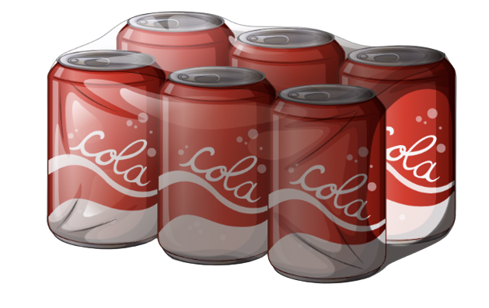
Tell a Story

Slide 3
3 x 6 = 18

Slide 4
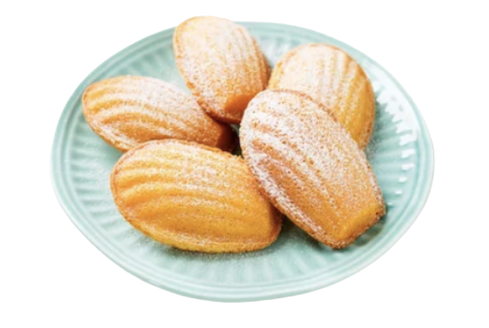
Tell me a story

Slide 5
5 x 5 = 25

Slide 6
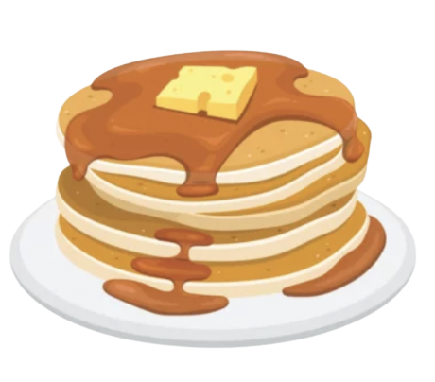
Tell me a story

Slide 7
3 x 5 = 15

Slide 8
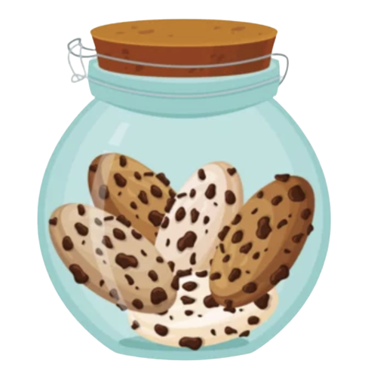
Tell me a story

Slide 9
3 x 5 = 15

Slide 10
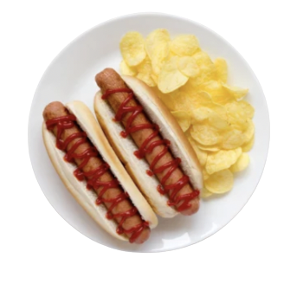
Tell me a Story

Slide 11
8 x 2 = 16

Slide 12
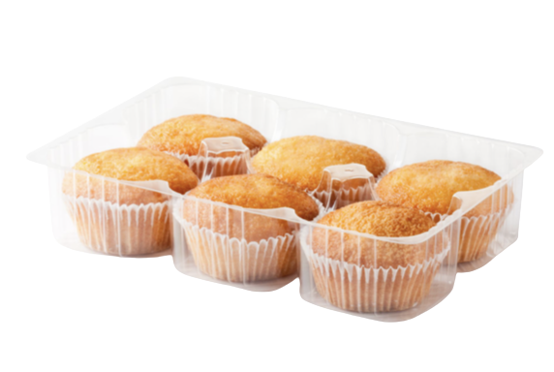
Tell me a story

Slide 13
5 x 6 = 30

Slide 14
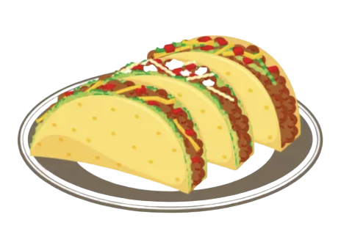
Tell me a story

Slide 15
3 x 3 = 9

Slide 16
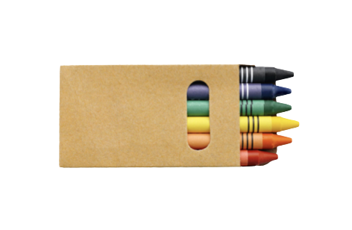
Tell me a story

Slide 17
5 x 6 = 30

Slide 18
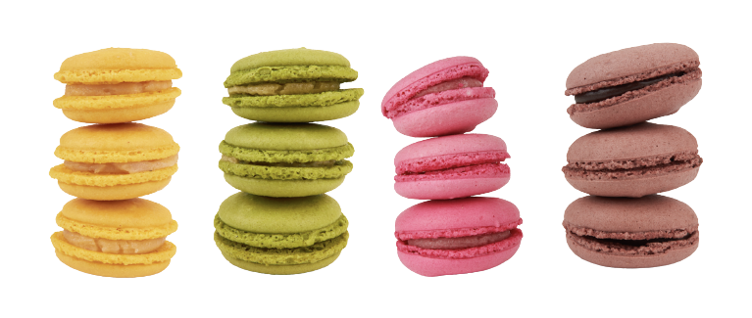
Tell me a story

Slide 19
4 x 3 = 12

Slide 20
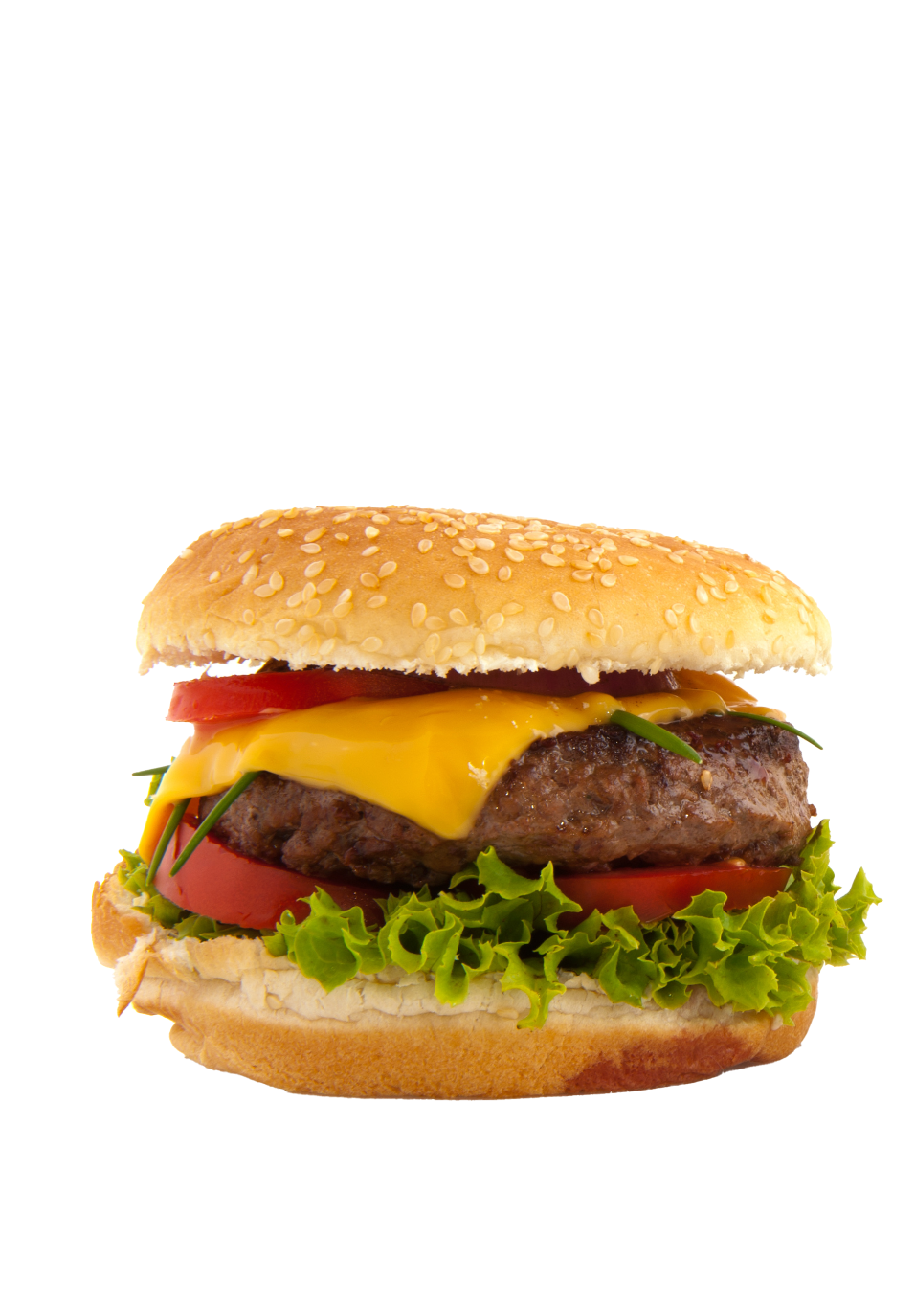
Tell me a story

Slide 21
3 x 2 = 6

Slide 22
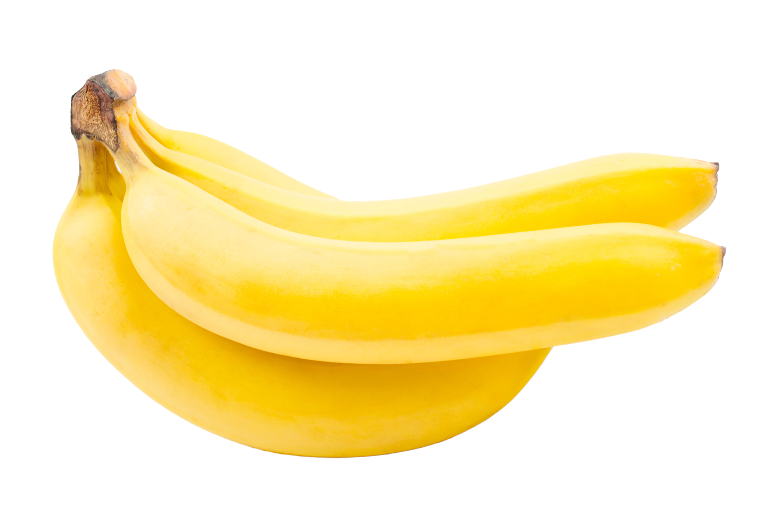
Tell me a story

Slide 23
4 x 3 = 12

Slide 24
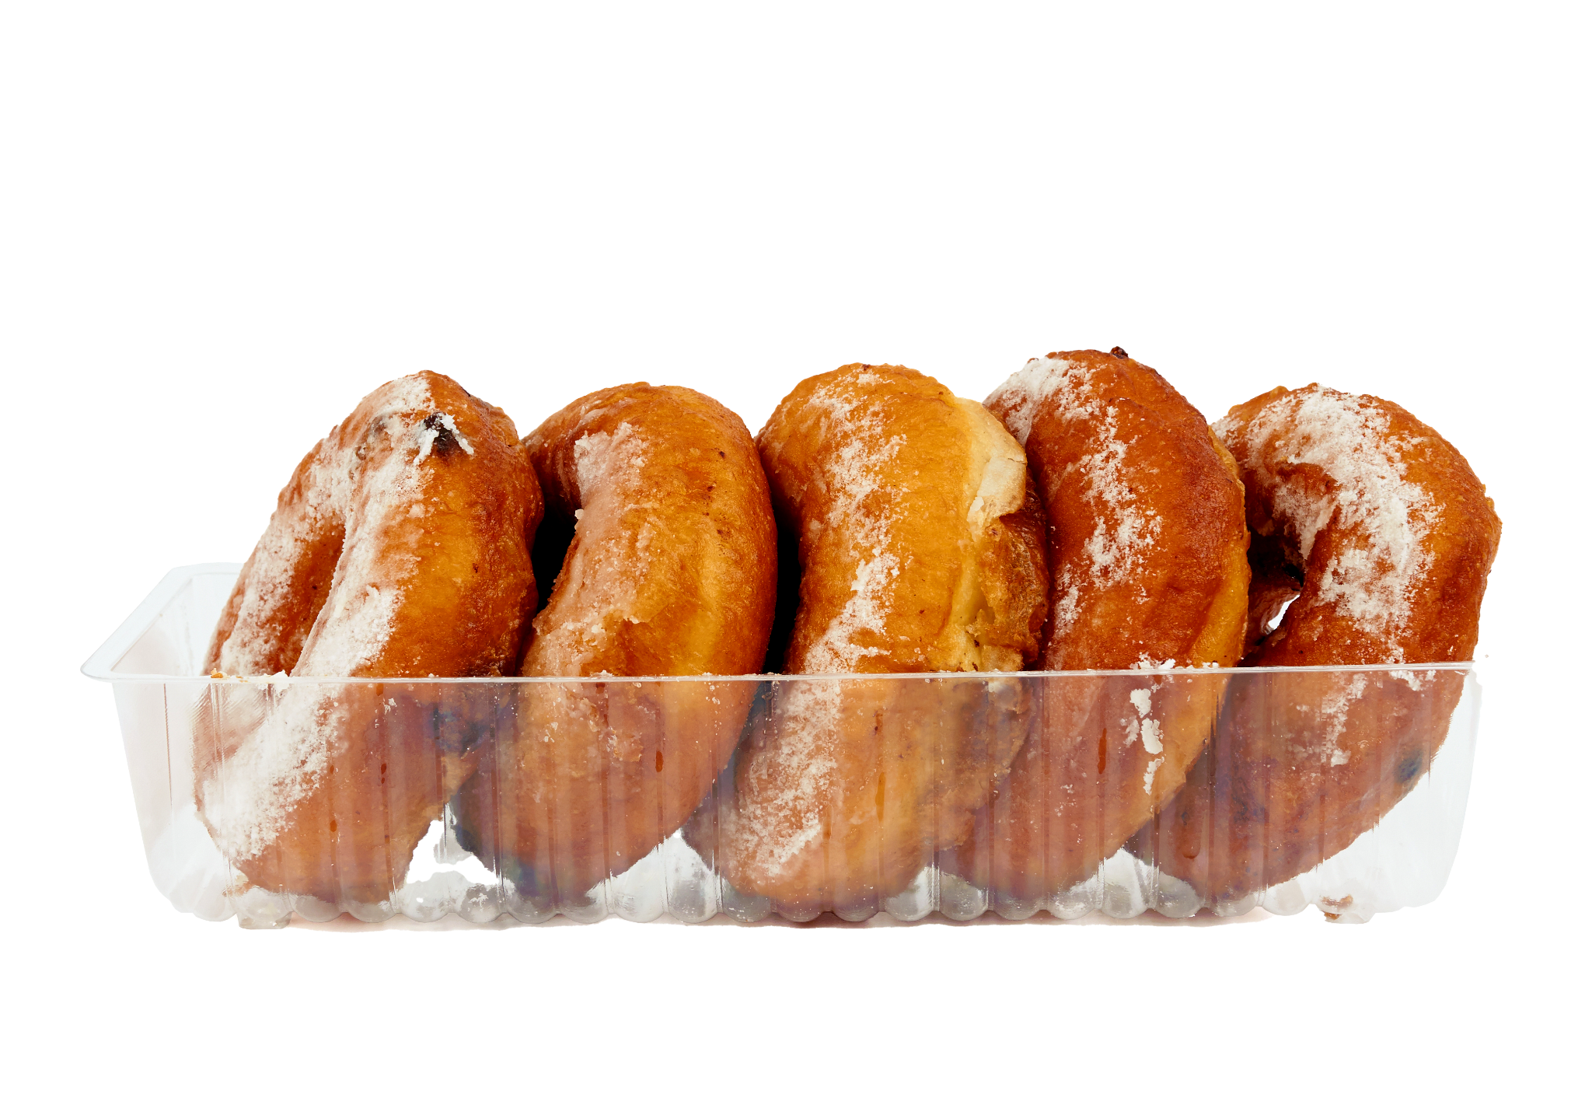
Tell me a story

Slide 25
4 x 5 = 20

Slide 26

Tell me a story

Slide 27
3 x 5 = 15

Slide 28

Tell me a story

Slide 29
5 x 6 = 30

Slide 30
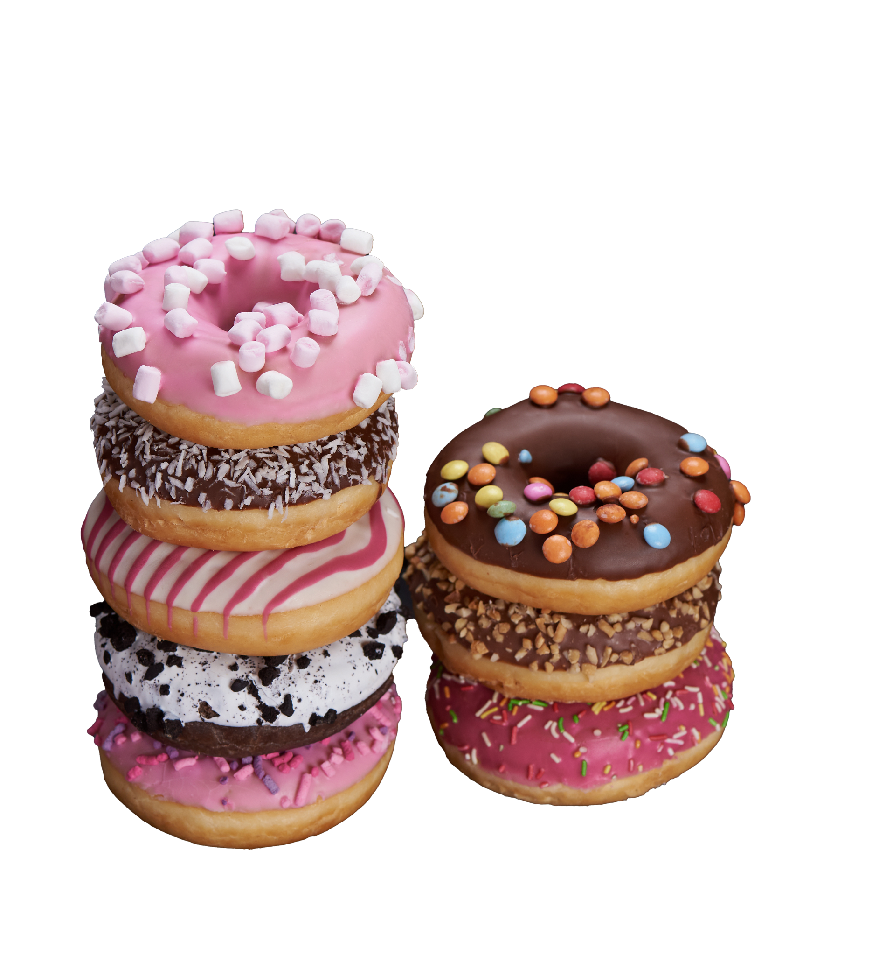
Tell me a story

Slide 31
7 x 8 = 56

Slide 32
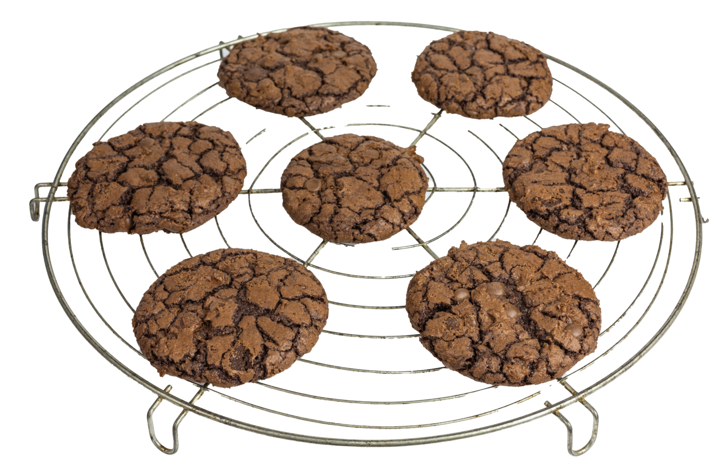
Tell me a story

Slide 33
10 x 7 = 70

Slide 34
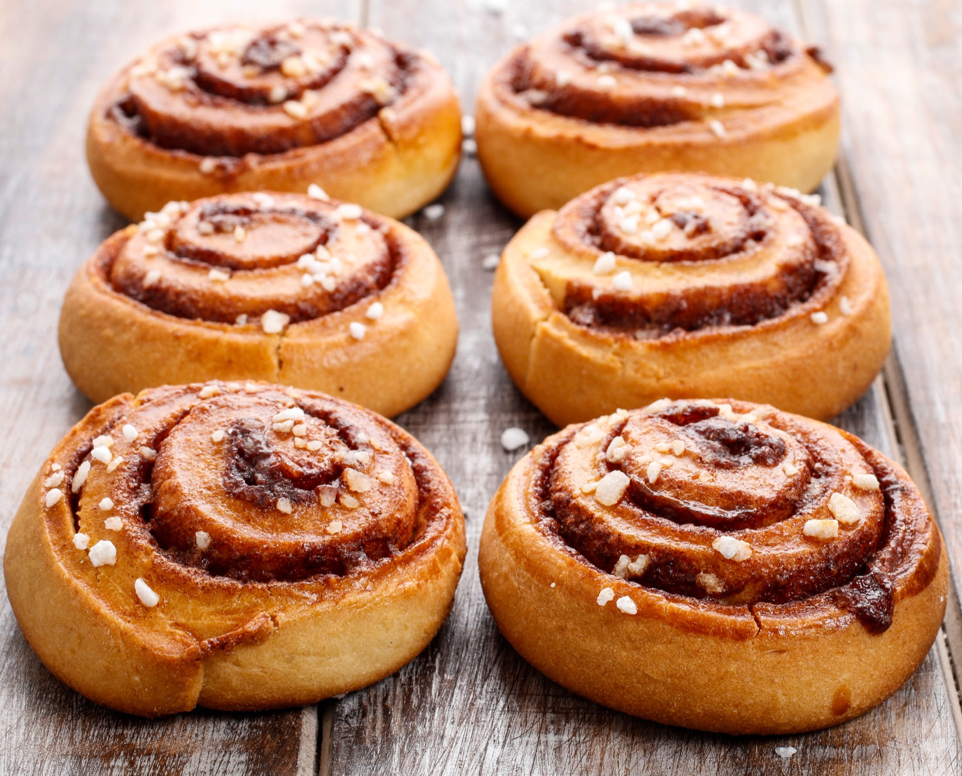
Tell me a story

Slide 35
3 x 6 = 18

