Slide 1
ADDITION CHATS
By Dr. Nicki Newton

Slide 2
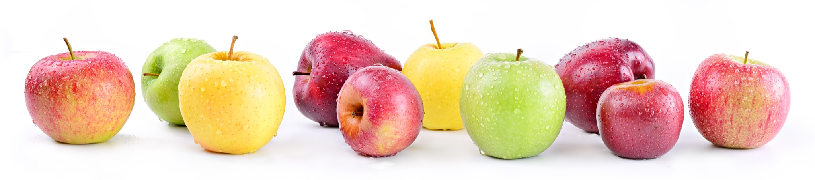
Tell me a story

Slide 3

Tell me a story

Slide 4
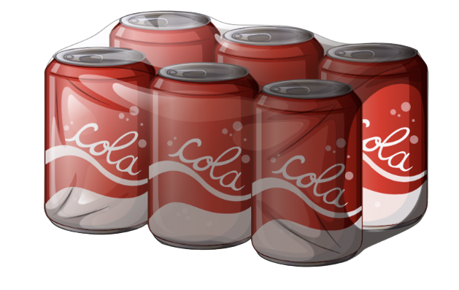
Tell a Story

Slide 5
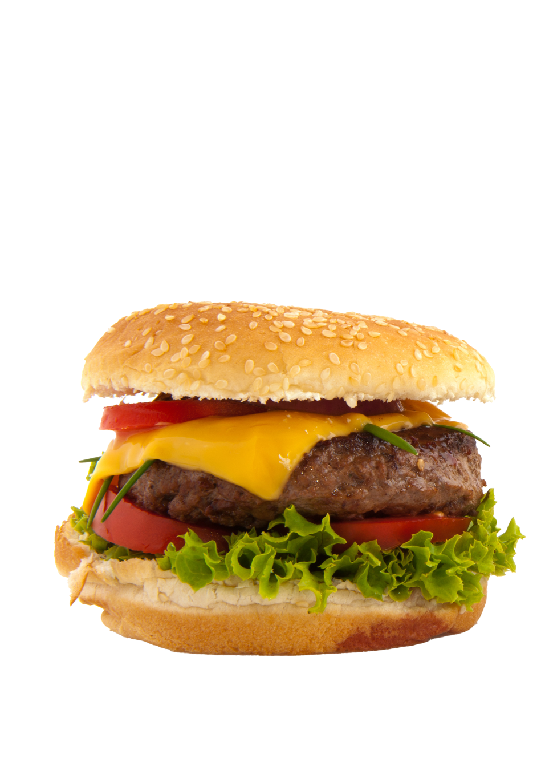
Tell me a story

Slide 6
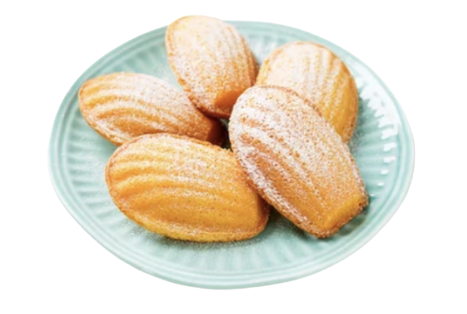
Tell me a story

Slide 7

Tell me a story

Slide 8

Tell me a story

Slide 9

Tell me a story

Slide 10

Tell me a story

Slide 11
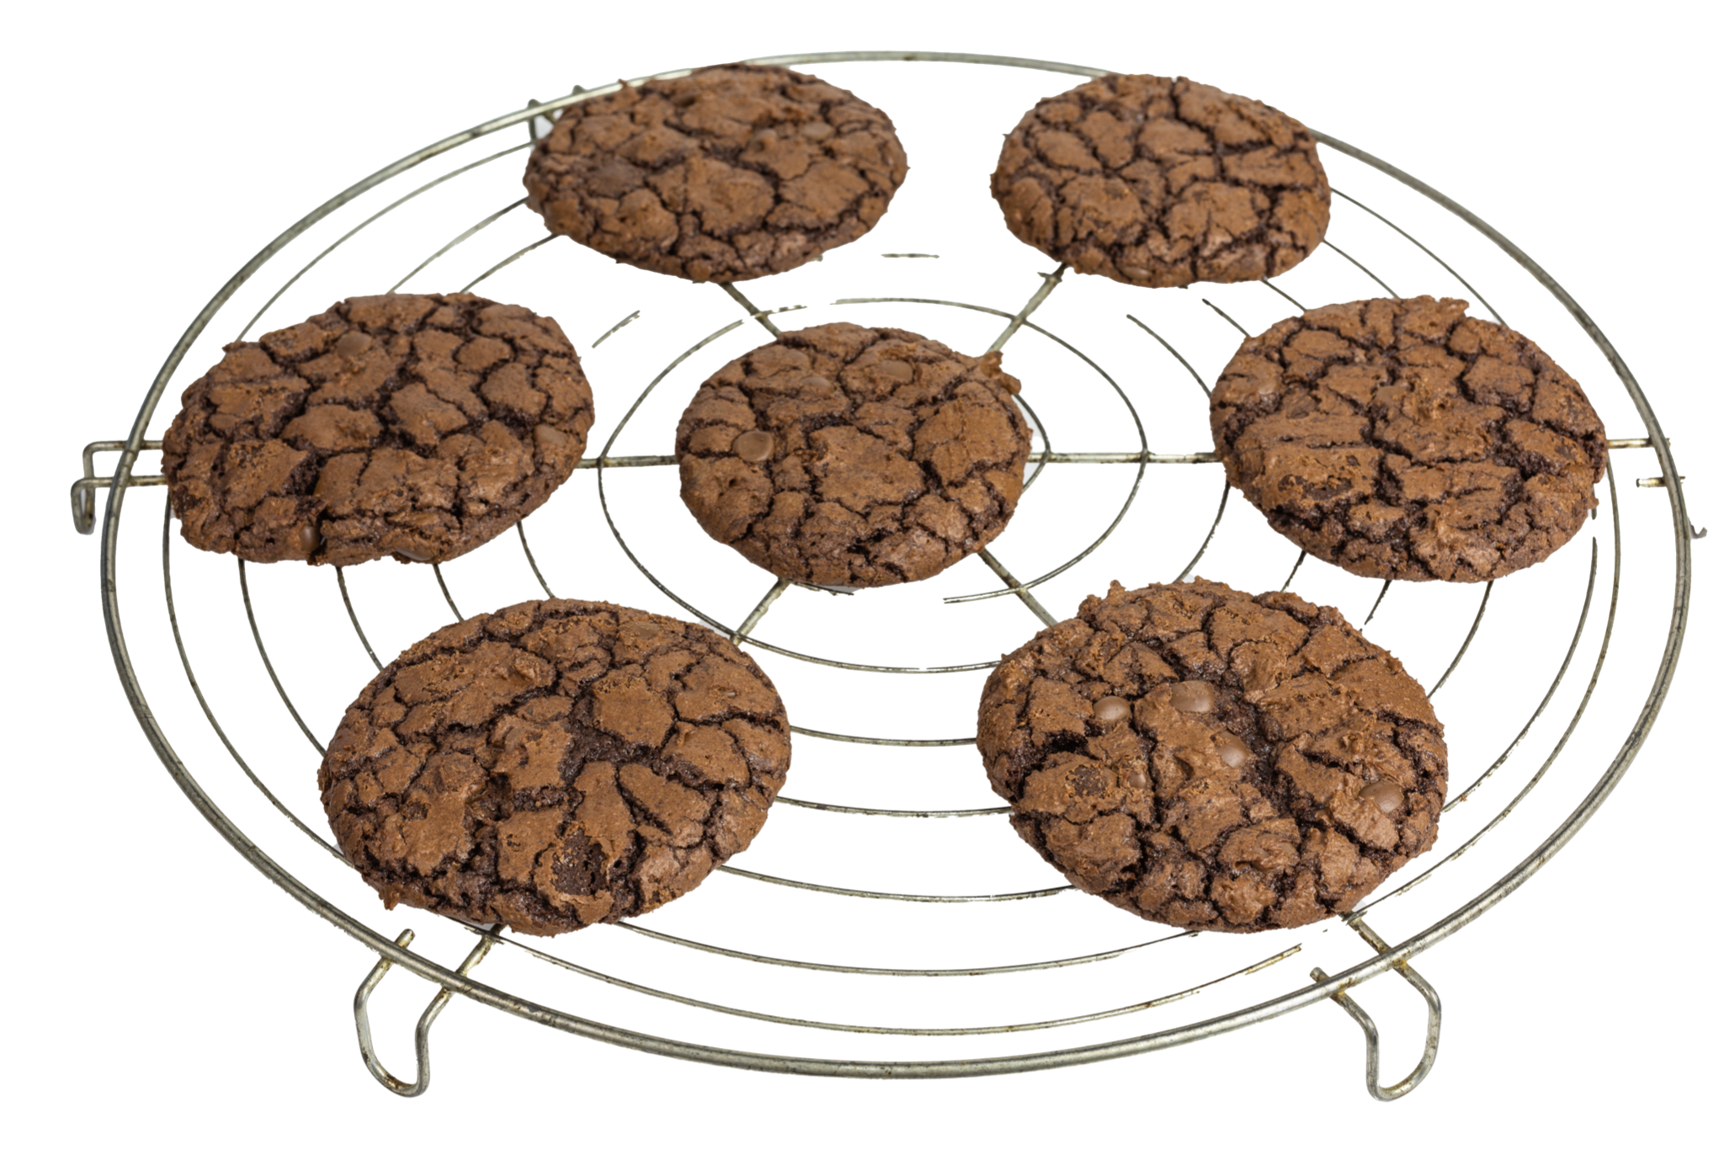
Tell me a story

Slide 12

Tell me a story

Slide 13

Tell me a story

